Slide 1
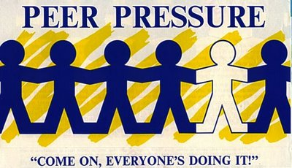
PBL
Jason Martin
Julian DeSouza
Parker Harris
Raquel Flores

Slide 2
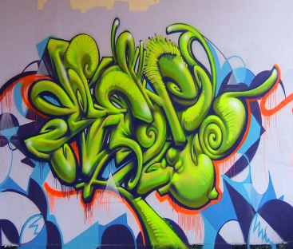
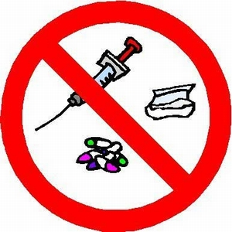
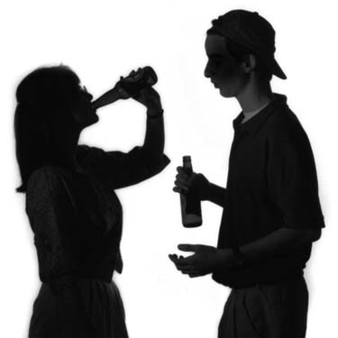
Basics of Conformity
“Conformity at its root is not a negative thing; it helps others to be able to depend upon us.”
“Bandwagon conformity”, the type of conforming that is not the result of any thought or desire for the greater good.
We do certain things because we believe that we're doing what we're "supposed" to do based on the ideas and reactions of other people
We engage in destructive behavior such as:
-Smoking
-Drinking
-Casual sex
-Drug use
-Vandalism
Want for others to approve of us leads to constant self awareness.

Slide 3
Conformity In Media
Media drives teens to question their looks and actions.
Girls are affected by models and television shows like “America’s Next Top Model.”
-Skinny figure
-Perfect complexion
-Weight
Girls are driven to extreme lengths to be “perfect” developing diseases such as:
-Anorexia
-Bulimia
According to the U.S. National Institute of Mental Health:
-About 3.7% girls and women will develop anorexia
-About 4.2% will develop bulimia

Slide 4
Conformity In Media
Problems also, derive from music.
Wiz Khalifa glorifies smoking the illegal drug marijuana.
-People who idolize him may partake in smoking.
Marijuana use for adolescents has risen 275% from 1992 to 1997 (National Household Survey on Drug Abuse).
This may be due to music tempting teens with lyrics of drugs being fun with no side effects such as:
“She’s my weed roller and when I’m with her guarantee I’m never sober.”

Slide 5
Common Ages of Conformity
The most vulnerable ages of Conformity are the 12-18 year old bracket.
As a teenager our minds are not fully developed which leads to lapses in weighing actions versus consequences.
Children's Hospital Boston neuroscientist Frances Jensen, MD, found in her discoveries:
-“That teenagers' brains are only about 80 percent fully developed and that brain development isn't complete until people reach their 20s or even 30s” (Graham).

Slide 6
Consequences of Giving In
Teens may be pushed to have sex so others will have more respect for them.
Statistics on peer pressure for sex: 50% of 12-17 year olds (Kaiser Foundation).
4 million sexually transmitted diseases infect teens each year.
Real life situation of pressure:
-Teens going to a party surrounded by bad influences such as drinking and smoking.
80% of high school seniors admit to at least trying a drink
50% report having consumed alcohol during the last month (“Alcohol News”).

Slide 7
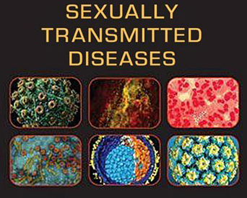
Peer Pressure = Sex
Peer pressure is usually associated with many problems
-Bullying, drinking, and premarital sex, both of which run rampant among teenagers.
According to the Teen Dating Abuse Survey (2007) conducted by Liz Claiborne Inc. and Teenage Research Unlimited:
-“In 2009, 46% of high school students had sexual intercourse and 13.8% had four or more sex partners during their life” (Sofs).
-“Approximately 19 million new STD infections occur, and almost half of them are among youth ages 15-24” (Sofs).

Slide 8
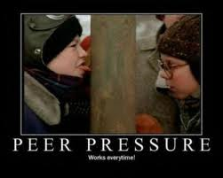
Solution?
Possible solution:
- If kids are taught at a young age to disregard peer pressure or even create positive peer pressure, the issue will be resolved.
“Peer education can be used to reinforce school-based curriculum programs or to reach more vulnerable youth subgroups,” says Ana File, a Cook Islands Red Cross Society youth volunteer .
-These days, teachers broach the problems caused by peer pressure, but do not dig deep enough to actually prevent them.

Slide 9
Solution? (Continued)
If adults were to show the outcome of how caving into peer pressure can hurt them in the long run, it might shock kids so much that they will resolutely stand their ground .
Parents and teachers need to show their children and students the consequences of coping media icons blindly.
-There needs to be a want to show students that being your own person is not always a bad thing. People can be alone and be efficient.

Slide 10
Conclusion
Teenage years are some of the most difficult.
-Friends, the fear of being different and excluded, and social media all drive teenagers to act irrationally, despite what they know to be right.
If teenagers are taught to stand for their beliefs and moral code, then there can be a future where youths are more self-confident and positive.
Being your own person can lead you to develop your own opinions and ideas which lead may lead to progression and a brighter future worldwide.

Slide 11
WORKS CITED
"College Women at Risk for Eating Disorder May Benefit From Online Intervention." College women at risk for eating disorder may benefit from online intervention. N.p., 2006. Web. 27 Mar 2012. <http://www.nimh.nih.gov/science-news/2006/college-women-at-risk-for-eating-disorder-may-benefit-from-online-intervention.shtml>.
. "Conformity." faqs.org. N.p., n.d. Web. 26 Mar 2012. <http://www.faqs.org/health/topics/2/Conformity.html>.
Graham, E. "The Teenage Brain." Dream online. Children’s Hospital Boston, 2008. Web. 28 Mar 2012. <http://www.childrenshospital.org/dream/summer08/the_teenage_brain.html>.
Hellmich, N. "Do Thin Models Warp Girls' Body Image?" USA today. USA TODAY, 2006. Web. 28 Mar 2012. <http://www.usatoday.com/news/health/2006-09-25-thin-models_x.htm>.
Marcalina, H. "Statistics on Peer Pressure." www.teens.lovetoknow.com. Love To Know, n.d. Web. 27 Mar 2012. <http://teens.lovetoknow.com/Statistics_on_Peer_Pressure>.
Sofs,. "Top 10 problems teenagers face - teen issues89." Hub Pages. Hub Pages Inc., n.d. Web. 28 Mar 2012. <http://sofs.hubpages.com/hub/Its-hard-on-teens>.
Straker, D. "The need for: Conformity." Changingminds.org. N.p., 2011. Web. 26 Mar 2012. <http://changingminds.org/explanations/needs/conformity.htm>.
. "Underage Drinking." Alcohol News. George Mason University, 2005. Web. 27 Mar 2012. <http://alcoholnews.org/Underage drinking.html>.
Ytret, Positive peer pressure. N.p., 2007. Web. 28 Mar 2012. <http://www.redcross.int/en/mag/magazine2006_3/22-23.html>.

